Slide 1
Unit 1 For Live Session Assignment
Isabella Westlauer
1/22/2026

Slide 2
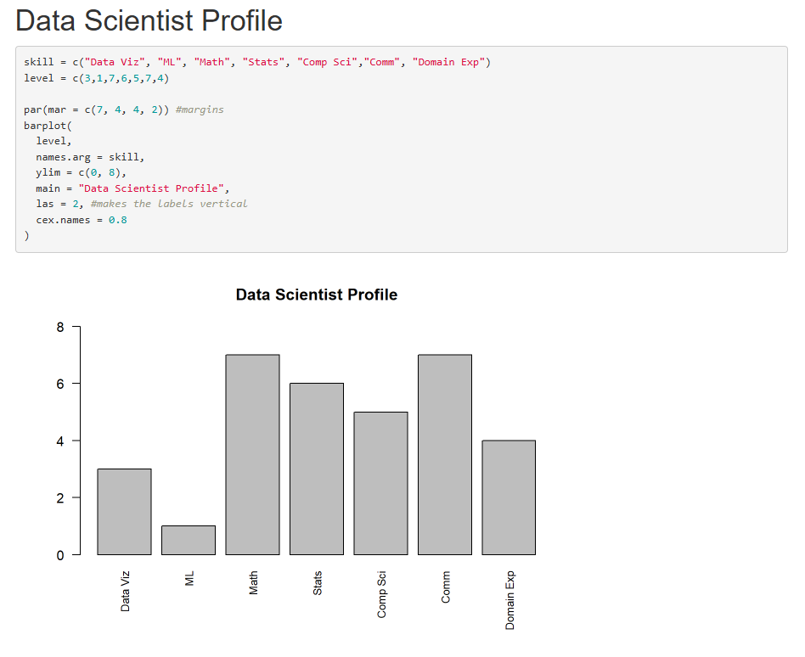

Slide 3
CLT
Using the central limit code from the asynch material (CLT2.Rmd), adapt the code and provide the following analysis

Slide 4
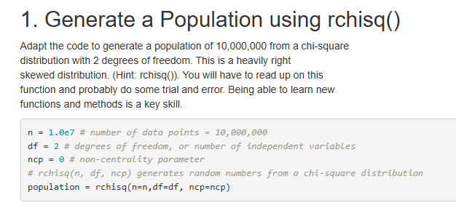

Slide 5
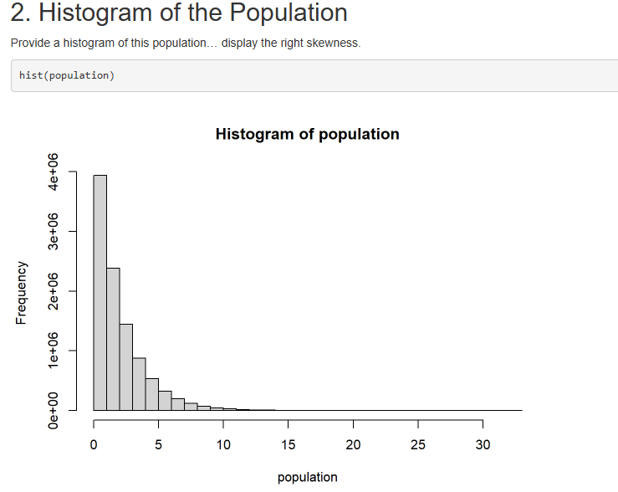
Does “right skewness” mean the population is all on the positive x-axis? Or, does it mean it’s shifted away from the y-axis more because df = 2?

Slide 6
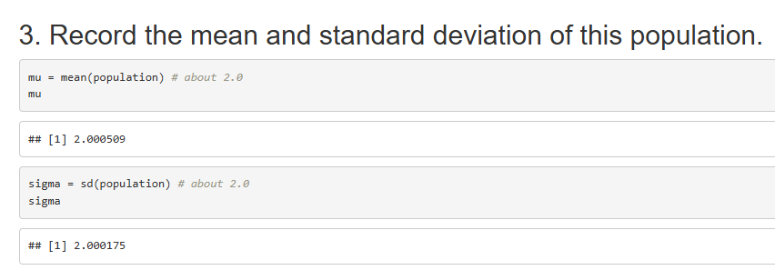

Slide 7
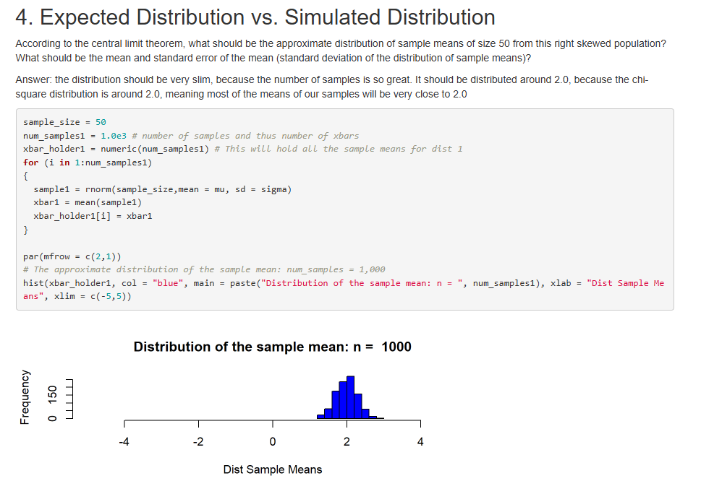
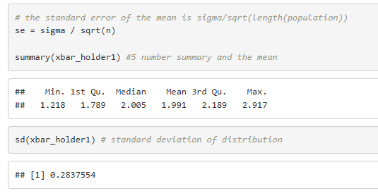


The theoretical standard deviation of the sampling distribution of the sample mean
$$σ_{\overline{x}}=\frac{σ}{\sqrt{n}}$$
$σ_{\overline{x}}=\frac{2}{\sqrt{50}}≈$0.283

Slide 8
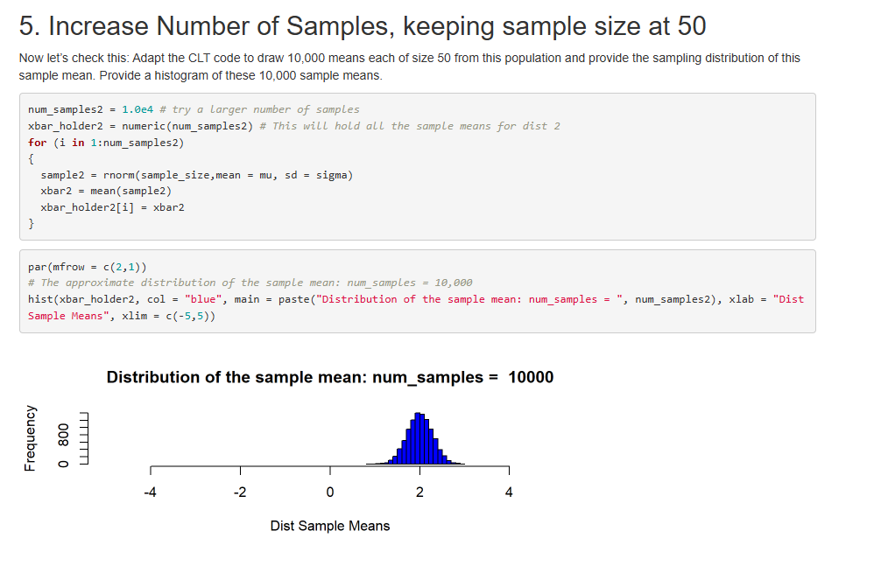

Slide 9
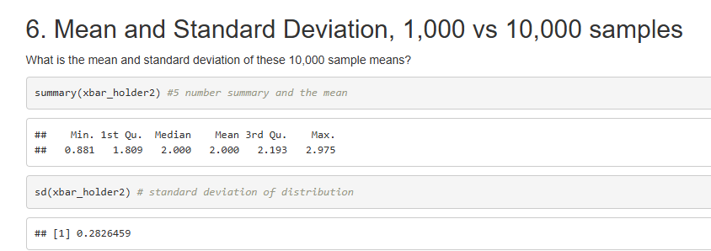
With 10,000 samples, the min is smaller and the max is larger than with our 1,000 samples, which makes sense. The median and the mean are closer to the median and mean of the original population than with 1,000 samples, which makes sense. The standard dev of the dist is still very close to the theoretical, 0.283.

Slide 10
Ask ChatGPT to try and address the previous question
https://chatgpt.com/share/6971d0c3-d664-8010-afdf-595d28dd7e76

Slide 11
T-Test
Research in R how to conduct a T-test (t.test) and conduct a six step hypothesis test to answer the question on the next slide. If you would like to brush up on hypothesis tests, please see the Bridge Course for Statistics.

Slide 12
The following are ages of 7 randomly chosen patrons seen leaving the Beach Comber in South Mission Beach at 7pm! We assume that the data come from a normal distribution and would like to test the claim that the mean age of the distribution of Comber patrons is different than 21. Conduct a 6 step hypothesis test to test this claim.
25, 19, 37, 29, 40, 28, 31
6 step hypothesis
State the hypotheses (null and alternative)
Set significance level (alpha)
Choose test statistic
Collect data and calculate
Make a decision
Interpret results

Slide 13
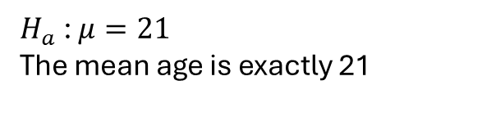
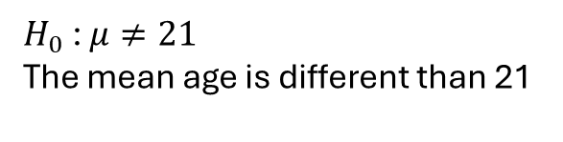
1. State hypotheses (null and alternative)
$H_{0}$ : $μ≠21$ The mean age is different than 21
$H_{a}$ : $μ=21$
The mean age is exactly 21
Two-tailed test: either the mean is exactly 21, or it’s less than 21, or it’s greater than 21.

Slide 14

2. Set significance level
What is the significance level? How confident are we about the null hypothesis? It’s very likely the mean is not exactly 21, so I’m pretty confident. How do we choose or calculate a significance level?
$$α=0.05$$

Slide 15

What kind of data is this? If I were to guess the average age of patrons without knowing any of their ages ahead of time, I would guess over 21 because it’s late in the evening and there’s a bar.

Slide 16
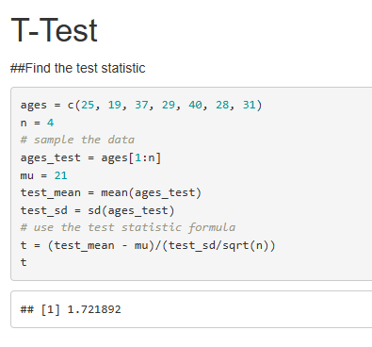
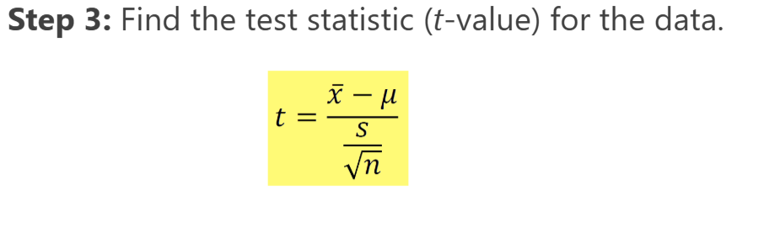
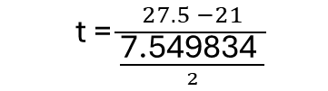
3. Choose test statistic
t = $\frac{27.5 −21}{\frac{\text{7.549834 }}{2}}$
Is it okay in this case to sample the data by just slicing the first 4 ages? Is it better to always use random(), even if the data is already in a random order?
Was I supposed to use n = 7, because that’s a sample of allllll the patrons?

Slide 17
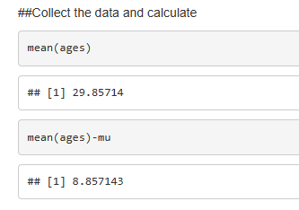
4. Collect data and calculate

Slide 18
5. Make a decision
The mean of the 7 ages was 29.8, which is not equal to 21. The null hypothesis was correct.

Slide 19
6. Interpret Results
The mean age of the 7 patrons was over 28, meaning that we were right to hypothesize that the mean age of all the patrons at that bar was over 21. What would the difference be if we took sample ages earlier in the day? When more children and teens are out at the beach? The mean age would probably be lower. What would the difference be if we took sample ages later, around closing time? Maybe it would be even closer to 21 because the more mature patrons had gone home.

Slide 20
Key Takeaways
Data scientist profile: there are different ways to plot and format a bar chart in R Studio, and we can export the image or use Rmarkdown and knitr and save an .html file for reproducibility
CLT: the chi-squared distribution is an exponential distribution, which is not a normal distribution but the sampling distribution of the sample means is approximately normal, and centered at the population mean. The histogram of the sampling distribution looks like a normal CLT curve, bell-shaped and centered at the population mean.
6-Step Hypothesis and T-Test: There are many scientific methods to test a hypothesis, this one is useful for answering a statistical question about a population using sample data. The two-tailed test is used when your hypotheses are just that some variable is or is not equal to a value, and there are only two outcomes.

